Slide 1
Vero Beach High School
Incoming 9th Graders
2020-2021
Class of 2024

Slide 2
Tonight’s agenda
Welcome
Graduation Requirements
Course offerings
Advanced Placement
Scheduling
Extra-curricular activities

Slide 3
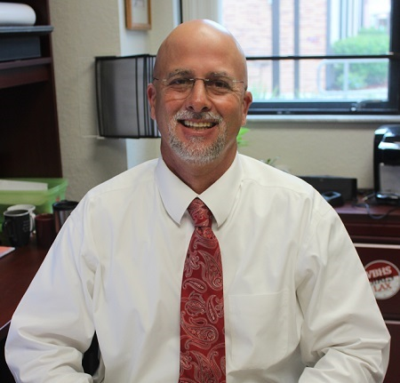
Principal – Shawn o’keefe

Slide 4
VBHS Assistant Principals
FLC
Robyn Bethel, (772) 564-5695
Robyn.Bethel@indianriverschools.org
Robert Riskin, (772) 564-5668
Robert.Riskin@indianriverschools.org
Main Campus
Greg Ahrens, (772) 564-5500
Rashard Morgan, (772) 564-5504
Vanessa Gonzalez, (772) 564-5503
David Erickson, (772) 564-5501

Slide 5
VBHS Guidance Department
FLC
Rachel Holderman, (772) 564-5717,
Rachel.Holderman@indianriverschools.org
Graduation Coach
Chris Rahal, (772) 564-5403
Main Campus
Jessica Wood, (772) 564-5536
Angela Combs, (772) 564-5532
Dawn Bennett-Campbell, (772) 564-5489
Holly Ohs, (772) 564-5496
Jackie Loughry, (772) 564-5515
Sophie Calixte, (772) 564-5516

Slide 6
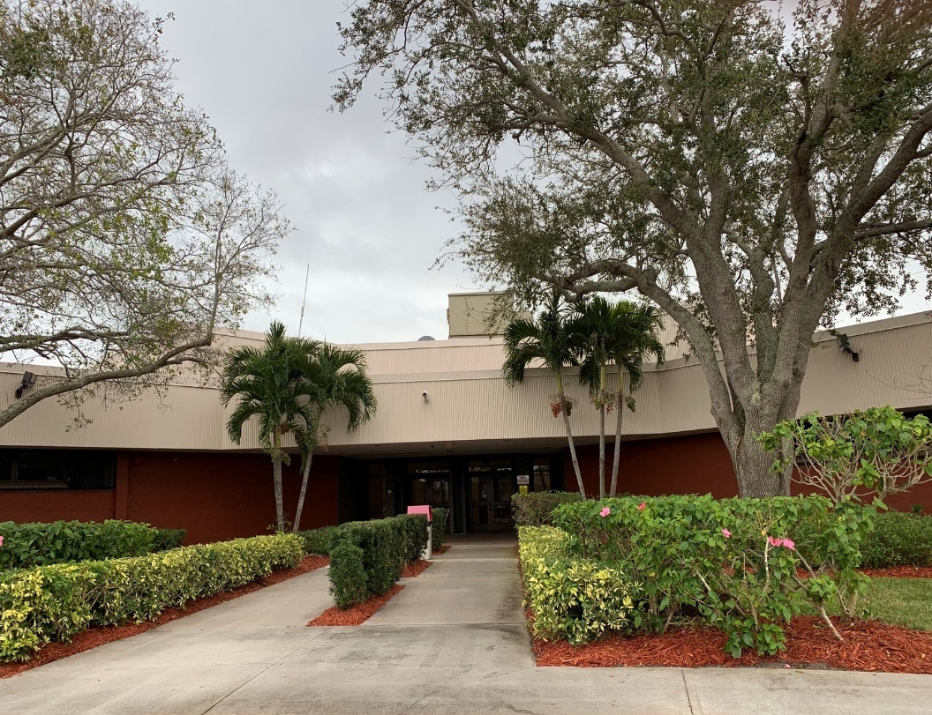
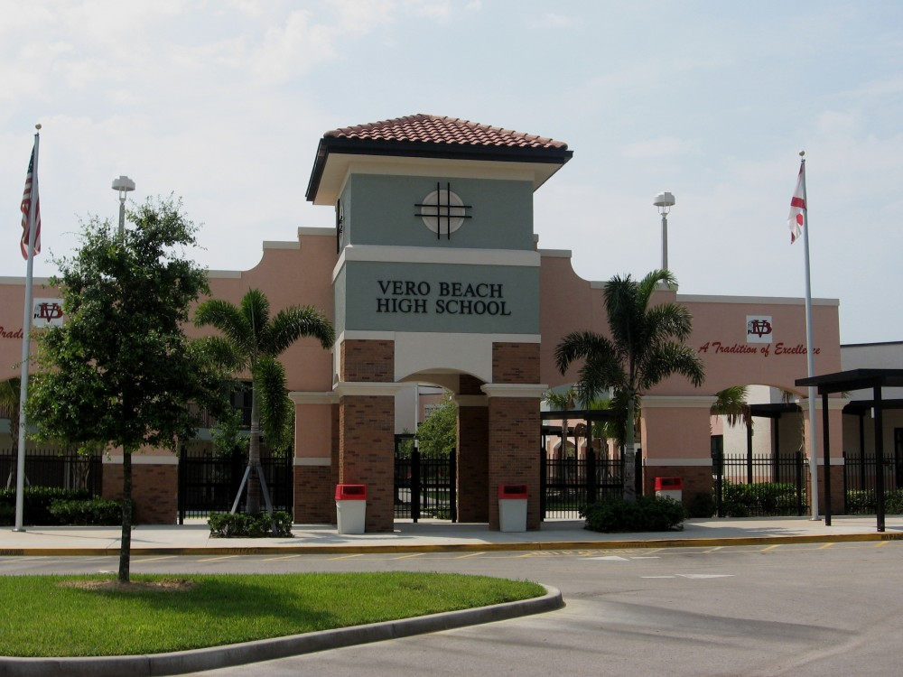
Vero Beach High School 1 School – 2 campuses
Freshman Learning Center (FLC)
Main Campus

Slide 7
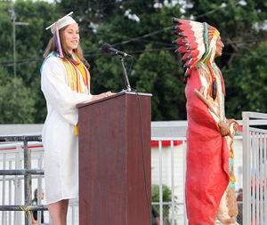
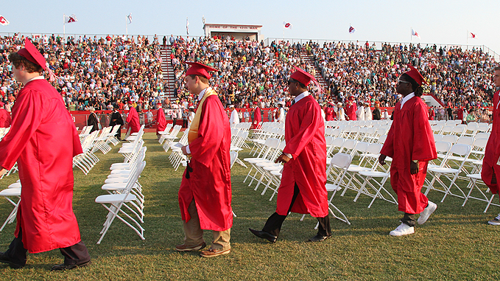
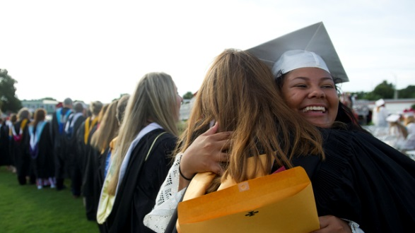
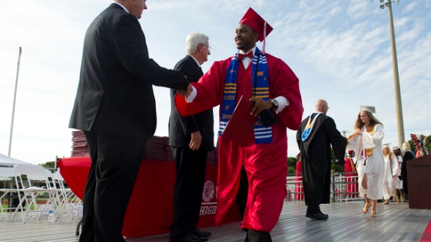
c2G Messages
Commit to goals
Commit to oneself
Commit to others
Commit to graduate

Slide 8
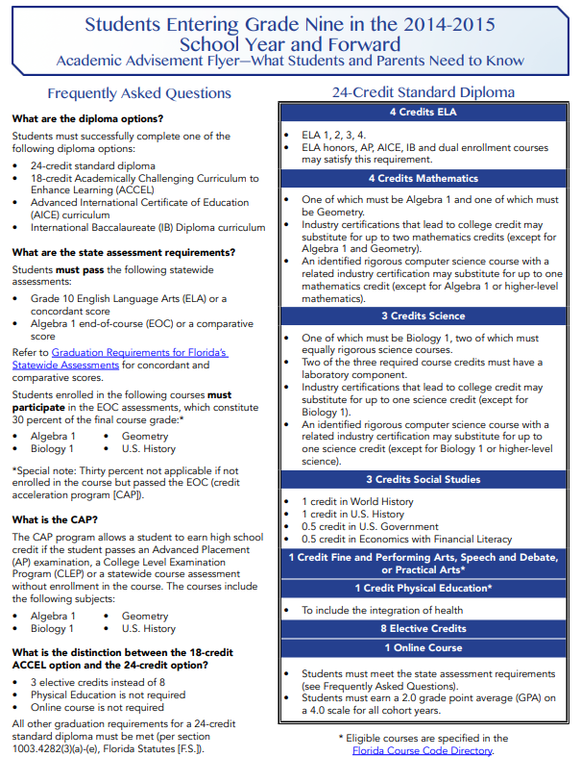
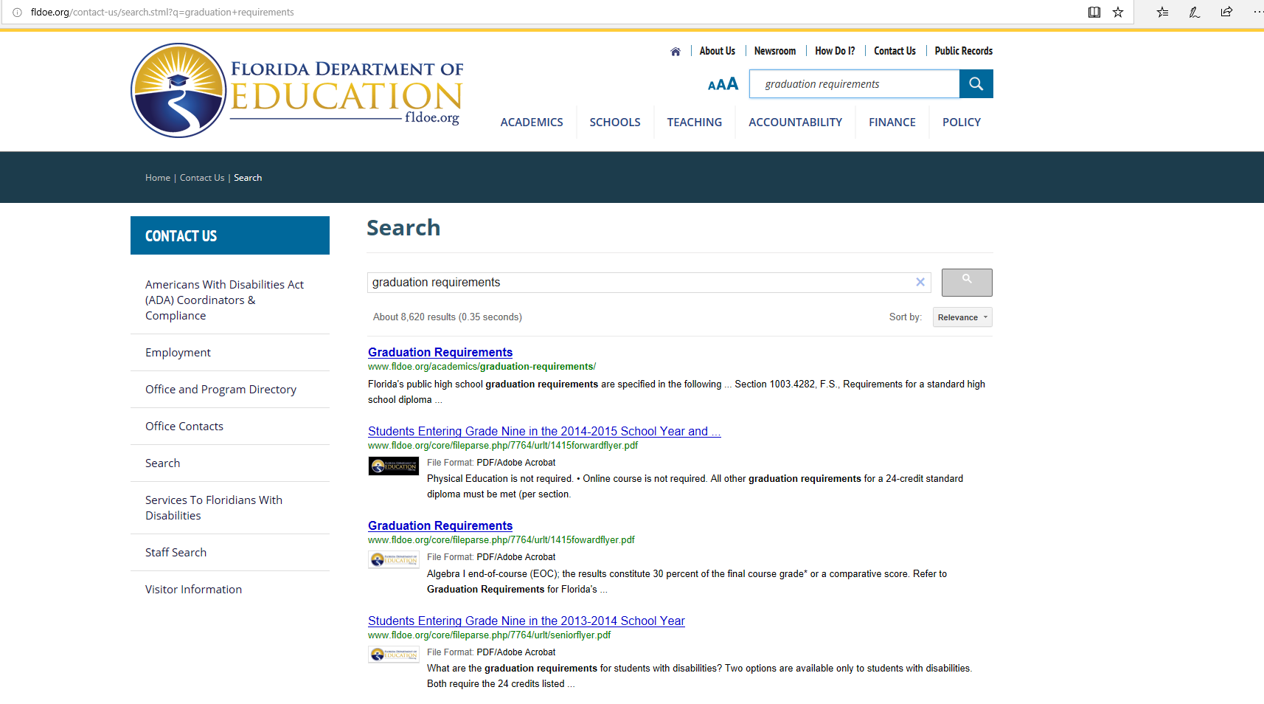
Graduation requirements
http://www.fldoe.org/academics/graduation-requirements/

Slide 9
2018-2019 Graduation Rate for the State
of Florida is 86.9%
After School PERT/ACT Prep Courses
Senior Checks
Underclassmen Checks
State Survey Monitoring and Data Corrections
Staff Development to increase sensitivity to student needs
21st Century Skills Embedded in the Classroom for College and/or Careers
VBHS GR
93.6%
2018-2019

Slide 10
Grade forgiveness
If you received a “C” or lower for any high school credited course you are eligible to retake the course for grade forgiveness.
This means the grade will completely be replaced by the new grade earned for GPA purposes.
This is important because your GPA is used for athletic eligibility as well as scheduling the following year.

Slide 11
What will my schedule look like?
7 periods a day, placement determined by FSA,
English 1 (Regular, Honors, or Honors with AP strategies)
Math: Algebra 1, Algebra 2, Geometry, or Liberal Arts
Science: Environmental (Regular or Honors) or Biology (Honors or Honors with AP strategies)
Physical Education: HOPE
Electives

Slide 12
electives
Spanish 1 & 2
French 1
*Band
*Jazz band – must audition
*Color Guard – part of the marching band/spring performances
*Performance chorus – requires after school rehearsal 1 day a week and performances
*Competition drama – must audition
*Jrotc – grooming standards and uniform required 1 day a week
Above electives are Year long. * designates required after school hours participation

Slide 13
Electives cont’d
2D Art - semester
Ceramics – semester
Weightlifting 1 and/or 2 – semester long, can be taken twice
Team Sports 1 and/or 2 – semester long, can be taken twice
Office aide – Semester - must not have any discipline referrals from 8th grade
THEATRE I – year long
DIGITAL Informational Technology – year long, meets online requirement for graduation
Chorus – year long, no outside of class requirements
AP COMPUTER Science Principles – year long, ap exam is taken in may (Pre-requisite: Algebra 1 must be completed)

Slide 14
Career & technical programs The Following programs begin in 10th grade
Marketing/MGMt./Entrepreneurial Princ.
Automotive maintenance & light repair
Industrial Biotechnology
Web application Development & Programming
Business MGMT. & Analysis
Architectural Drafting
Culinary arts
nursing assistant
Digital Video tech
Aviation assembly & Fabrication

Slide 15
An Introduction to the Advanced Placement Program®
Vero Beach High School

Slide 16
Advanced Placement ®: The Basics
AP® courses are college-level courses offered in high school
Courses reflect what is taught in top introductory college courses
Students take AP Exams at the end of the course, measuring their mastery of college-level work
A score of 3 or higher on an AP exam can typically earn students college credit and/or placement into advanced courses in college
Notes:
Presenter can add to this information with the following points:
Advanced Placement® is a program developed and overseen by the College Board, the not-for-profit organization that is responsible for the PSAT/NMSQT®, SAT®, and other programs and services in college readiness and college success that help more than seven million students each year prepare for a successful transition to college.

Slide 17
AP® Courses At VBHS
English: English Language and Composition, English Literature and Composition
History and Social Sciences: Art History, European History, Human Geography, Macroeconomics, Psychology, United States Government and Politics, United States History, World History
Mathematics and Computer Science: Calculus AB, Calculus BC, Statistics, Computer Science Principles
Sciences: Biology, Chemistry, Environmental Science, Physics 1
World languages:, Spanish Language, Spanish Literature, French Language
Art- Art 2-D Design, Art 3-D, Drawing
Notes:
Presenter will highlight courses in each content area

Slide 18
Human Geography
The goal for the course is for students to become more geoliterate, more engaged in contemporary global issues, and more informed about multicultural viewpoints.
Specific Topics in the course include:
Problems of economic development and cultural change
Consequences of population growth, changing fertility rates, and international migration
Impacts of technological innovation on transportation, communication, industrialization, and other aspects of human life
Struggles over political power and control of territory
Explanations of why location matters to agricultural land use, industrial development, and urban problems
The role of climate change and environmental abuses in shaping the human landscapes on earth

Slide 19
COMPUTER SCIENCE PRINCIPLES
AP CSP was created with significant support from the national science foundation. The college board also worked with high schools and higher education computer science educators who piloted the program at their institutions.
Along with the fundamentals of computing, they’ll learn:
Creative problem solving
How to apply computational processes to analyze large data sets
Programming and global impacts of computing
Internet structures and important cybersecurity issues
Students will also:
Use computer science to address real-world issues that interest them
Create programs or technology that have practical impact
Gain skills relevant across other disciplines and industries.

Slide 20
AP® at VBHS
1,690 AP Exams taken in 2019
14 National AP Scholars
45 AP Scholars with Distinction
33 AP Scholars with Honor
102 AP Scholars
60% Of our AP courses scored higher than the State Average
Notes:
Presenter can provide stats (if available) about the growth of the school’s AP program.
AP Scholars information [if needed]: https://apstudent.collegeboard.org/exploreap/the-rewards/scholar-awards

Slide 21
AP®: The Benefits
Students learn rigorous college-level content and skills
Taking AP is valued in the college admission process
AP courses are interesting and rewarding academic experiences
Opportunity to earn valuable credit and placement in college

Slide 22
AP®: Skills & Advantages that Last a Lifetime
Taking an AP course helps students build critical thinking skills, confidence, and the essential time management and study skills needed for college success
Nationally, research shows that students who score a 3 or higher on an AP Exam typically earn higher grade point averages in college and have higher graduation rates than their non-AP peers*
Most four-year colleges and universities in the United States grant credit, advanced placement, or both on the basis of successful AP Exam scores—more than 3,300 institutions worldwide annually receive AP scores.

Slide 23
AP®: A More Engaging Learning Experience
AP courses challenge students to work and participate at a higher level:
Opportunities to explore topics in depth
More time in and out of the classroom required to complete assignments and projects
High expectations for critical thinking, analysis, synthesis, evidence, multiple perspectives, and clear written and verbal communications

Slide 24
What’s Next
Have a conversation with your student
Download the AP Letter of Intent from the VBHS website
Complete it and Turn it in to your middle school guidance counselor or VBHS
Letters of Acceptance will be mailed to you in the first week of March
Attend the AP night at FLc ( learn more about the College board and Ap)

Slide 25
Learn More….
Contact Kere Minton for more information about the AP program at Vero Beach High School. # 564-5493
For more information about AP courses and exams visit- www.collegeboard.org
Visit our VBHS website and click on Advanced Placement to find information and updates

Slide 26
scheduling
Registration form can be changed prior to June
Guidance counselors will complete your schedules in June – provide us with as much information as possible
Dual enrollment – begins in 10th grade, you must have a 3.0 unweighted GPA
Florida Virtual Courses can be taken over the summer

Slide 27
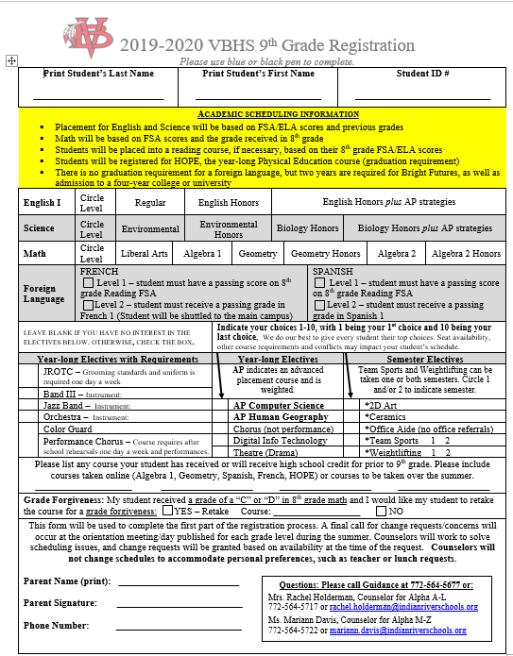
Registration form
We will visit all middle schools to complete registration forms for scheduling with students.
Gifford Middle – Time to be determined
Oslo Middle – To Be determined
Imagine – To Be determined
Storm Grove – To Be determined
St. Helen Catholic School – To Be determined

Slide 28
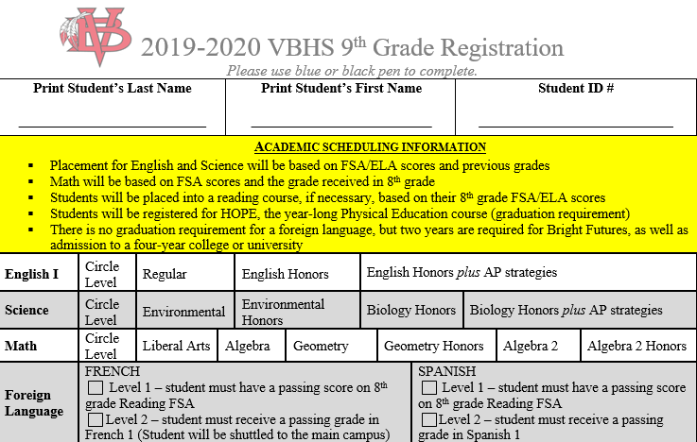

Slide 29
electives

Slide 30
Students will complete the registration form at their perspective middle schools in March.

Slide 31
Registration form
Visit our website - https://vbhs.indianriverschools.org
Select Students & Families
You will be able to access the presentation by Friday, February 3rd

Slide 32
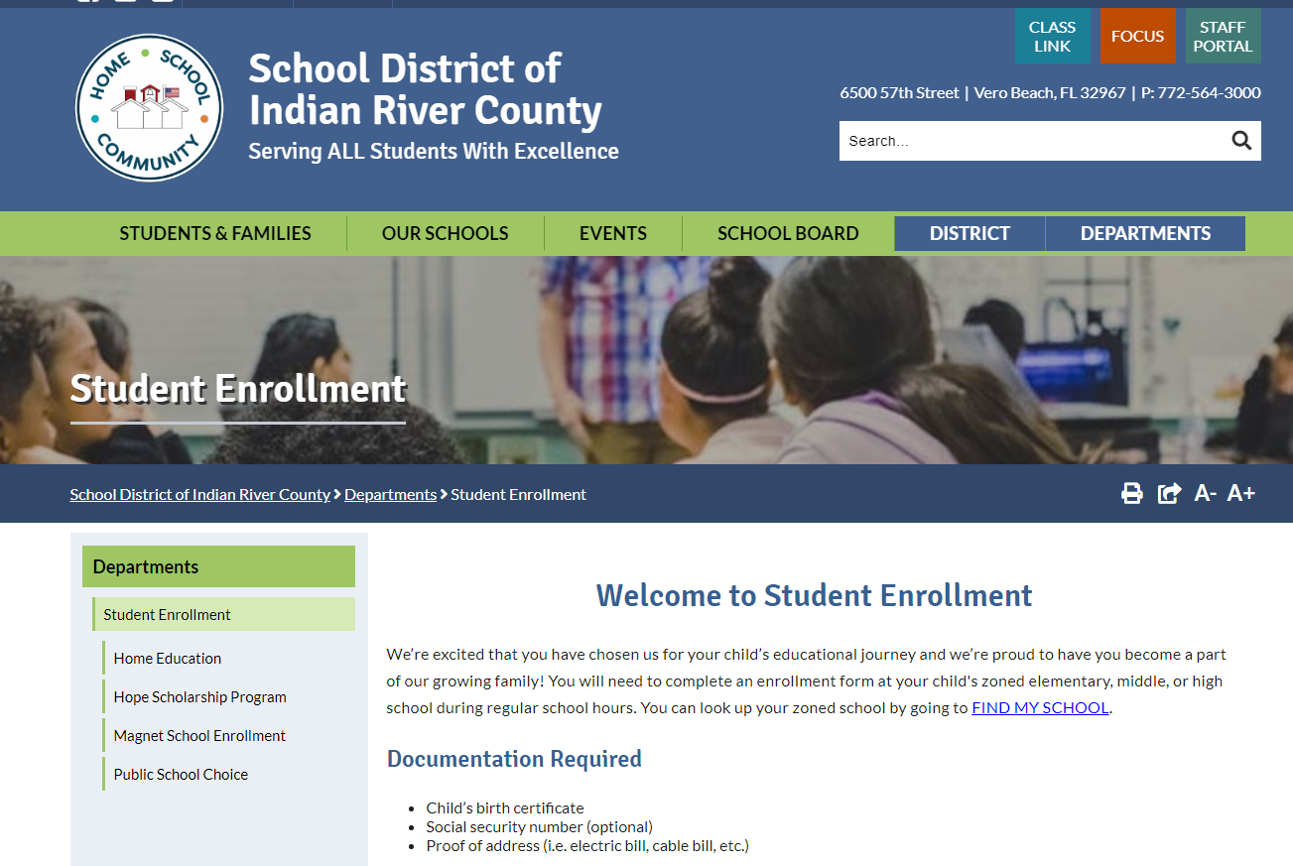
Enrollment
Enrollment Packets
Needed for students from Imagine, private schools, or out of county or state
School Choice – If you are not zoned for VBHS and interested … check the Students & Families Tab
www.indianriverschools.org

Slide 33
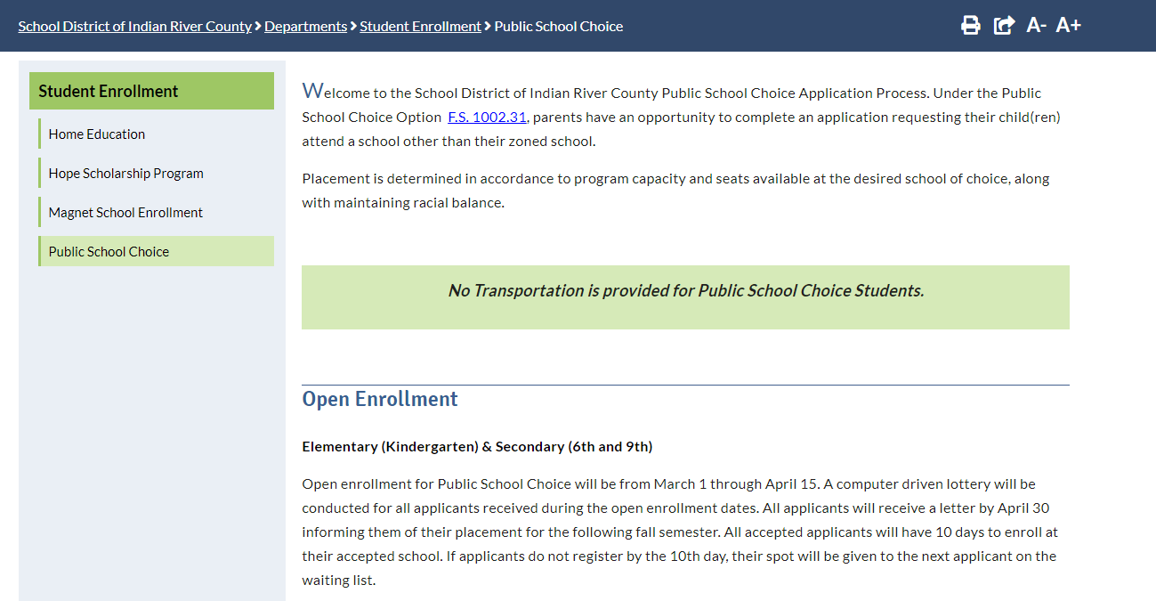
Enrollment

Slide 34
Athletic Director & head Football Coach
Lenny Jankowski
For information pertaining to football, please contact Coach Jankowski. Information includes, but is not limited to the following:
Spring Football Schedules
Off Season Workout Schedules
7 on 7 Schedules
Practice Schedules
Freshmen Football
Lenny.Jankowski@indianriverschools.org
772.564.5415 or 772.453.7507

Slide 35
DO YOU WANT TO BE A VBHS CHEERLEADER?
Parent/
Cheerleader
meeting
Wed. April 1
6:00 – 7:00 pm
Visit verovarsitycheerleading on leaguelineup.com

Slide 36
Requirements for athletics
Minimum of a 2.0 gpa
Current physical
Player packet
$65 pay to play fee (per year, not season)
Free physicals will be later in the spring – continue to check our athletic website

Slide 37
sports
Fall
winter
spring
Football
golf
Cross country
Swimming
Volleyball
Bowling
basketball
soccer
weightlifting
Wrestling
Cheerleading
Baseball
Girl’s flag football
lacrosse
Softball
Tennis
Track and field

Slide 38
Performing arts – Page Howell
Page.Howell@indianriverschools.org
772.564.5413

Slide 39
Performing arts
Band
Jazz Band
Color guard
Orchestra
Chorus
Drama
Competition drama

Slide 41
As an incoming 9th grader… remember
1. Put Academics First
2. Stay Involved
3. Be YOUR Very Best
C2G – Committed to Graduate

Slide 42
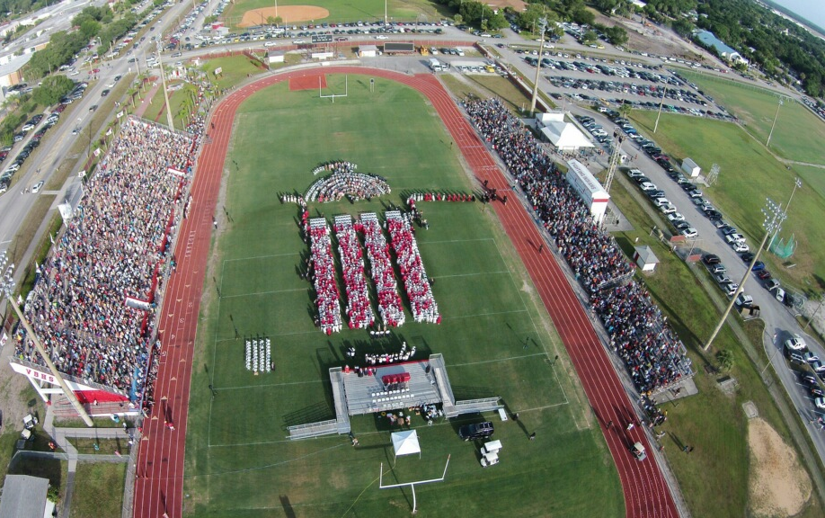
Be a part of your big picture
Your future starts august 2020!

