Slide 1
The Shining Sharks
Sebastian River High School
School District of Indian River County

Slide 2
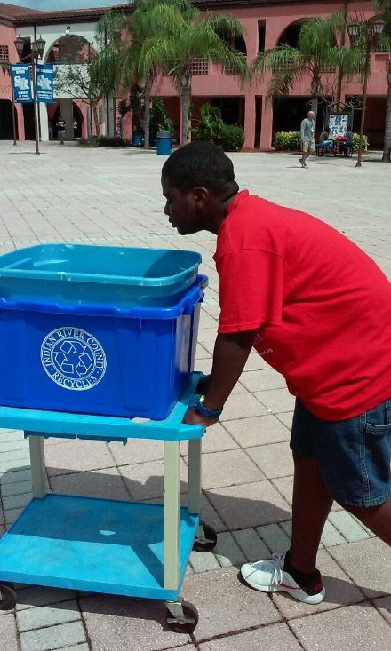
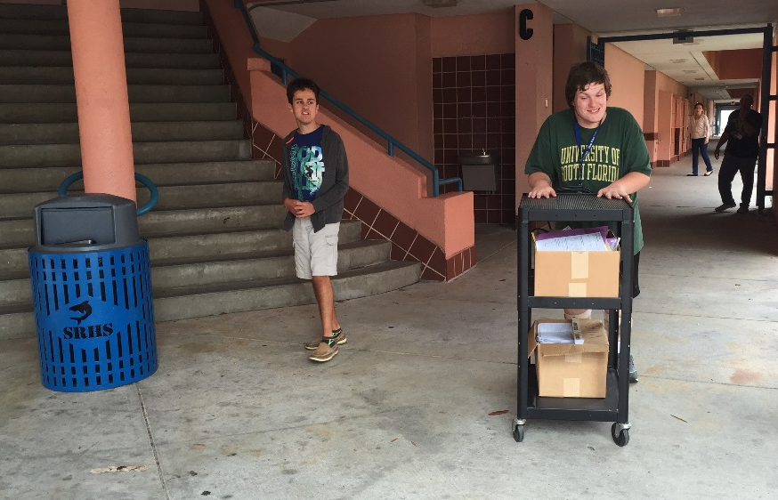
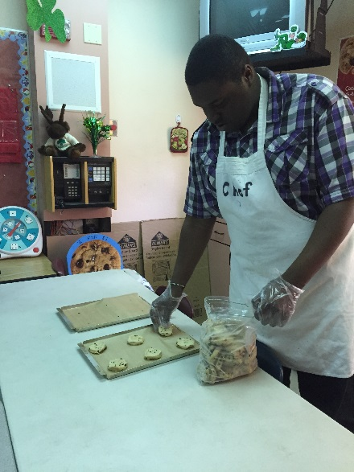
In the Beginning
In 2010 the Shining Sharks career experiences program was launched at Sebastian River High School. We had one classroom and one job task – baking cookies.
Since then, multiple job stations have been added across campus, collaboration between four classrooms, and over 25 students are involved!

Slide 3
Real World Work Experience
Students participating in this program follow a weekly rotating schedule. Some of the jobs include:
Bake cookies
Collect paper/plastic recycle
Stepping stone production
Cafeteria/Library clean-up
Gardening
Handcrafted Notecards
Laundry
School-wide teacher assistance (shredding, pencil sharpening, etc)

Slide 4
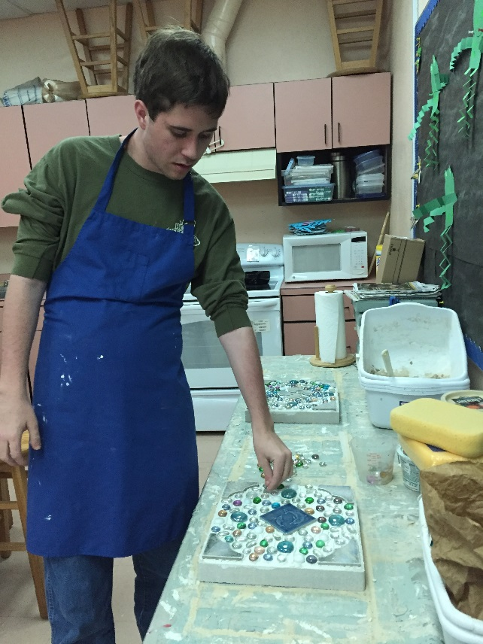
Job Training programs are essential for students with special needs
Students experience real world work situations
Many of the job stations are revenue producing. This gives meaning to the work the students are doing. Profits go into an account to pay for Community Based Instruction, Classroom supplies, and Socials.

Slide 5
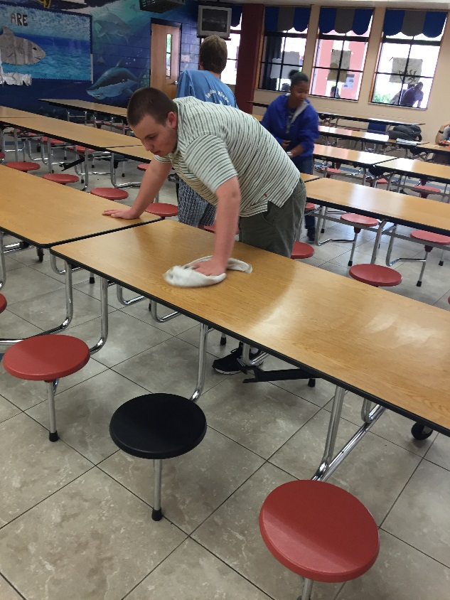
Students rotate through multiple job stations
Students rotate weekly to five work stations across campus. Within each station will be a variety of job tasks. Students of all ability levels have the opportunity to participate in the program.
Experiencing a variety of jobs gives the students self-determination to make decisions about what they would choose for a career in the future.

Slide 6
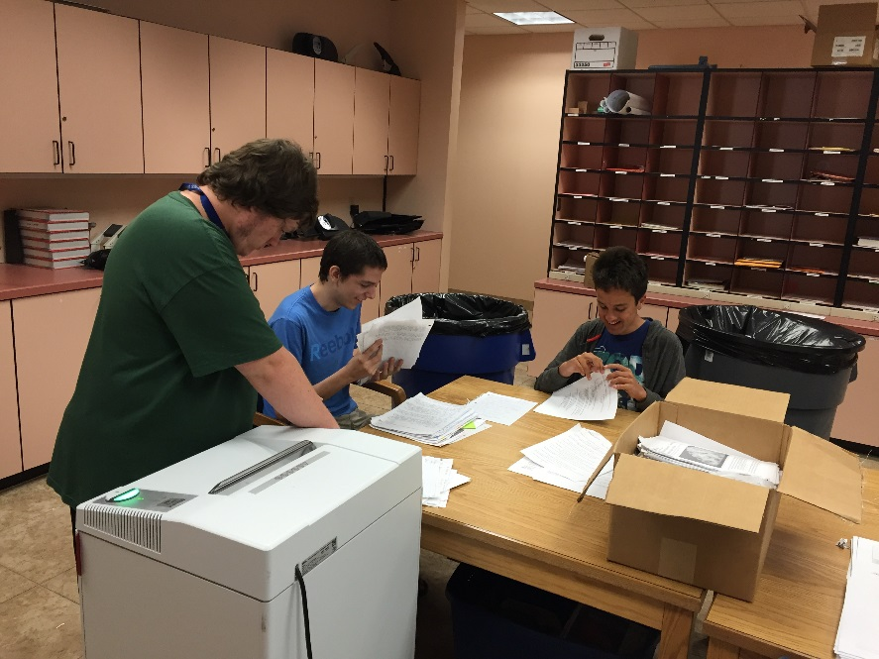
Students learn self advocacy, endurance and respect
Students learn what it’s like to have a supervisor, how and when to ask for help, endurance to work a full shift, and proper social skills when speaking with supervisors and co-workers.

Slide 7
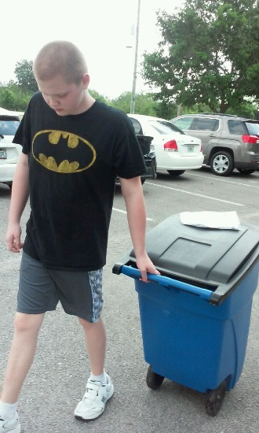
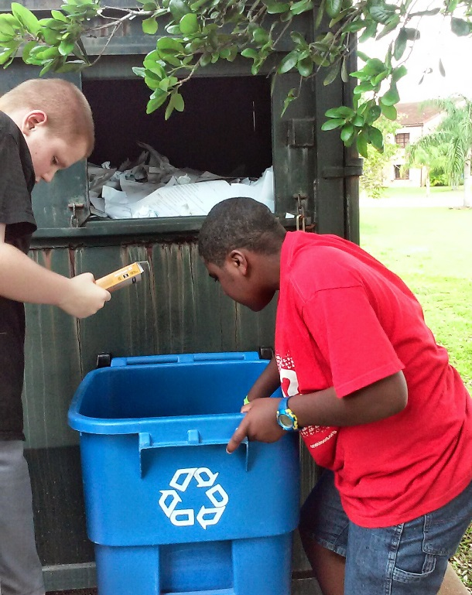
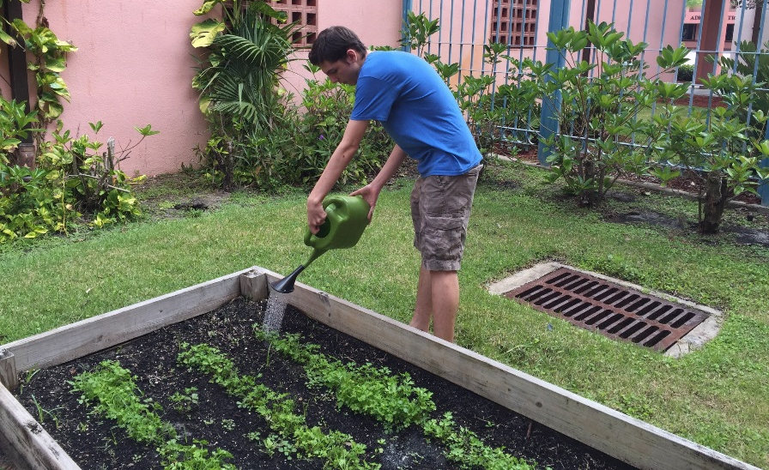
Students prepare for transition to life after high school
This program gives students a taste of what it will be like in an actual job.

Slide 8
Typical Schedule for Job Task
Job Begins
Sign in on time sheet
Determine job tasks for day
Endurance
Start task
Job Ends
Ask supervisor for next task
Remain on task until completion
Sign out on time sheet

Slide 9
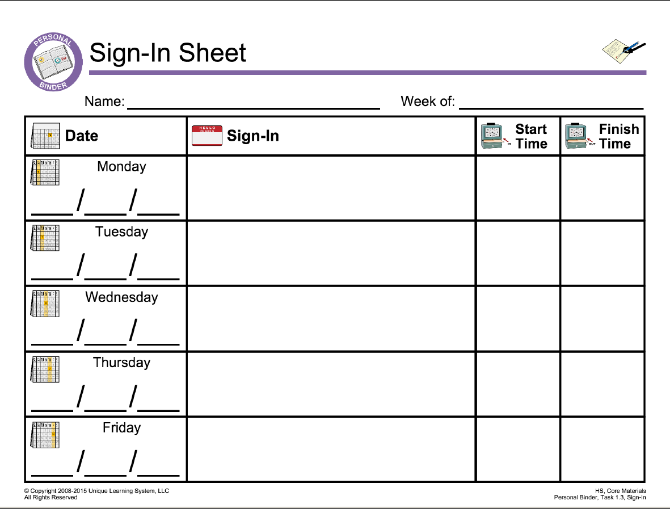
Job Evaluations
Students set goals for their work and are evaluated daily for job performance.

Slide 10
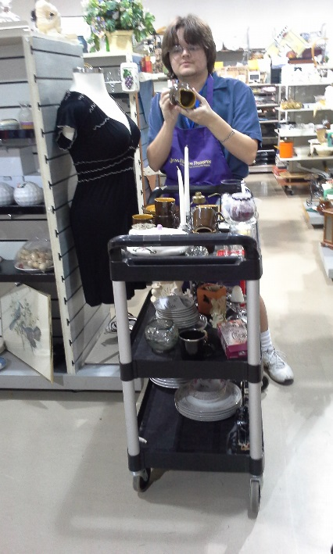
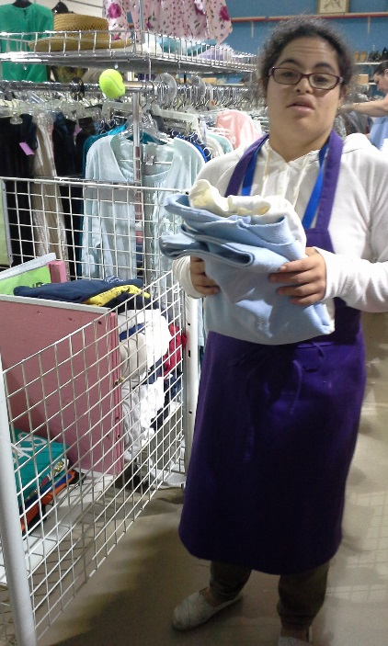
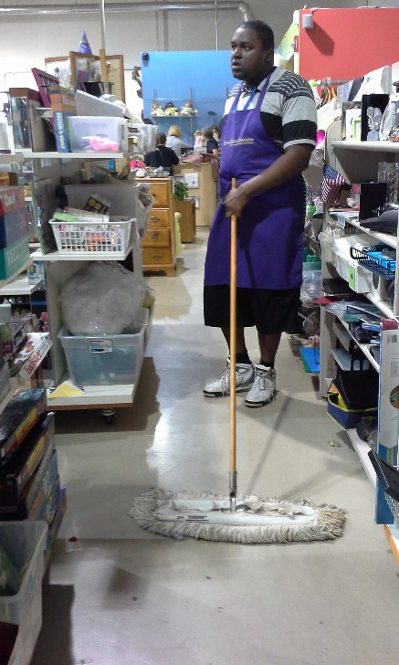
Project Hidden Treasures
In 2014 Project Hidden Treasures was added to the program. This is an off-campus job experience for students. Students who qualify, travel to the site and participate for a half day working for VNA Thrift Stores.

Slide 11
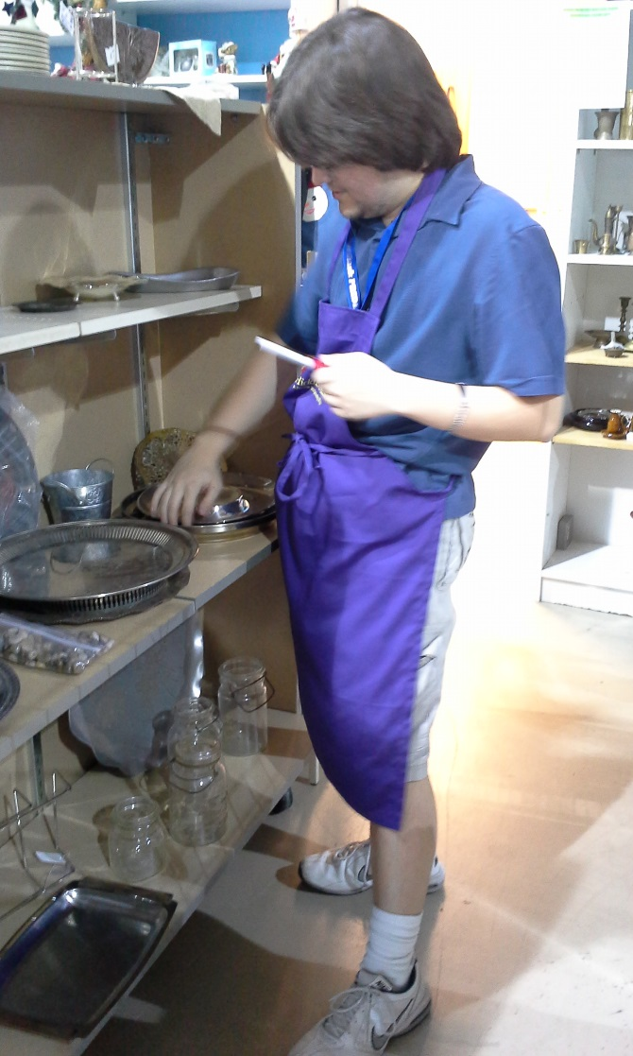
Project Hidden Treasures
Students participate in a variety of job tasks at the thrift store including sorting and hanging clothes, stocking shelves, helping at the register, and cleaning up.

Slide 12
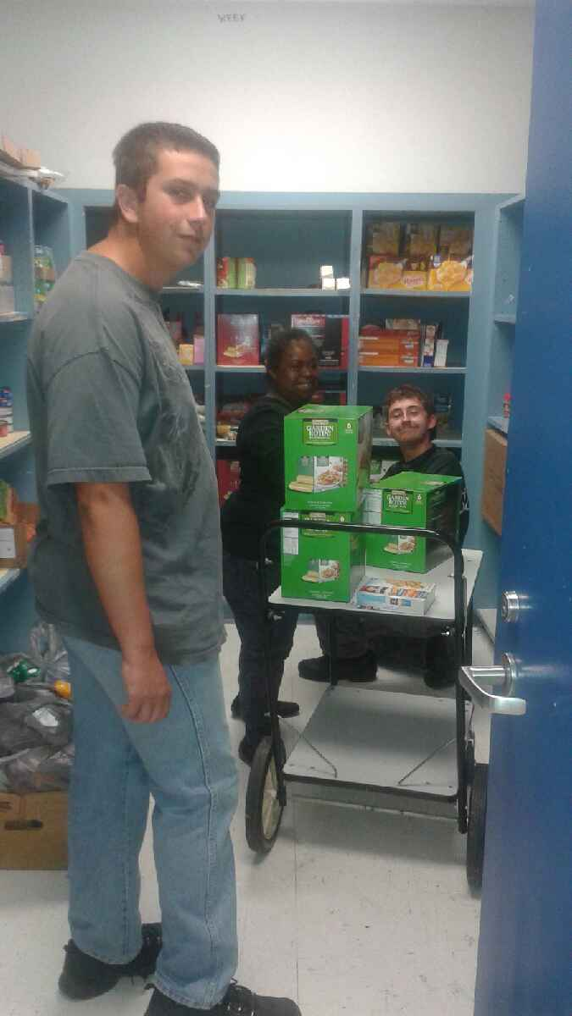
Chum Bucket
Added just this year to our on-campus program is working for Chum Bucket. Chum Bucket is a charitable program at Sebastian River High School. This organization started with four families and now services over 50 families with food, clothing, school supplies, fees for sports, and fees for school events.

Slide 13
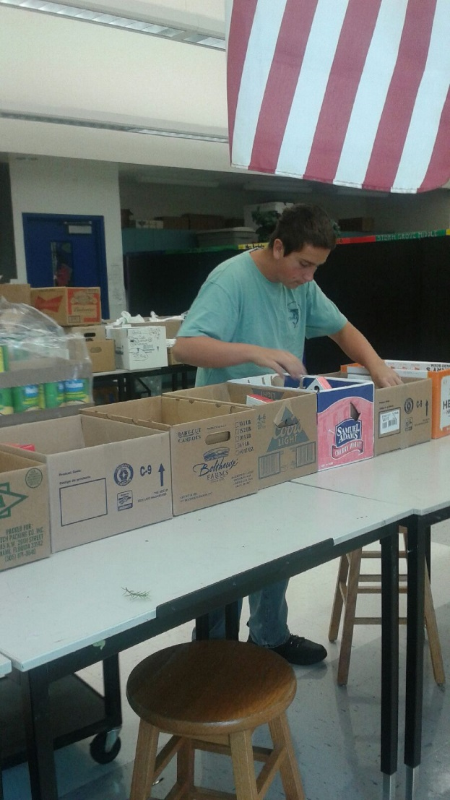
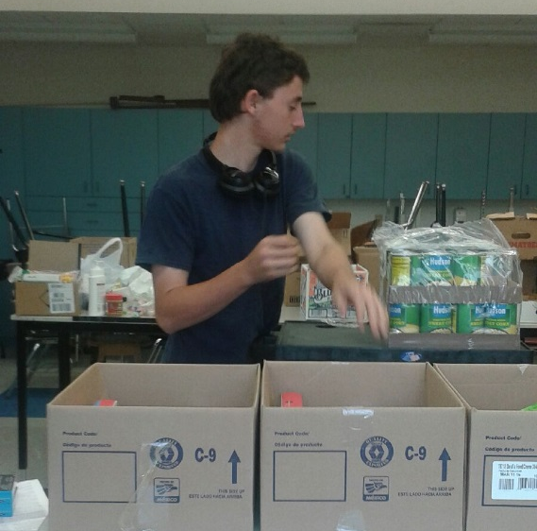
Chum Bucket
Our higher level ESE students work with the program managers to independently unpack, sort, fold, and organize items donated. They then put together care packages for families in need.

Slide 14
Shining Sharks job programs
https://youtu.be/Kt4tZWU4OBo
https://www.youtube.com/watch?v=eZOEKv7qKZ8

Slide 15
Transition Programs in Indian River County
Development of the job training program is our central goal of offering experience in work for our students. More venue sites for off campus training are needed to increase opportunities for all students to be able to participate.
Our goals are for the further expansion of this transition program in Indian River County so that all students can be prepared to transition to life beyond high school.

Slide 16
Shining Sharks
Brenda Truesdale ESE Teacher, Autism
Sebastian River High School
Shiningsharks.com
(772) 564-4186
Collaborating Classroom Teachers:
Brenda Truesdale
Kathryn Pfeffer
Tyrone Perry
Regina Richards

